Slide 1
Fundamentals of Hive
Notes:
Hi

Slide 2
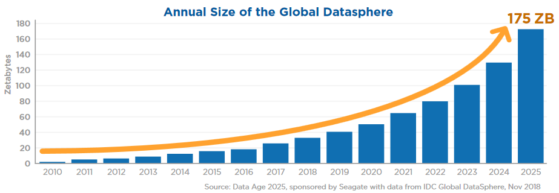
Notes:
As you know, data is growing at a phenomenal rate.

Slide 3
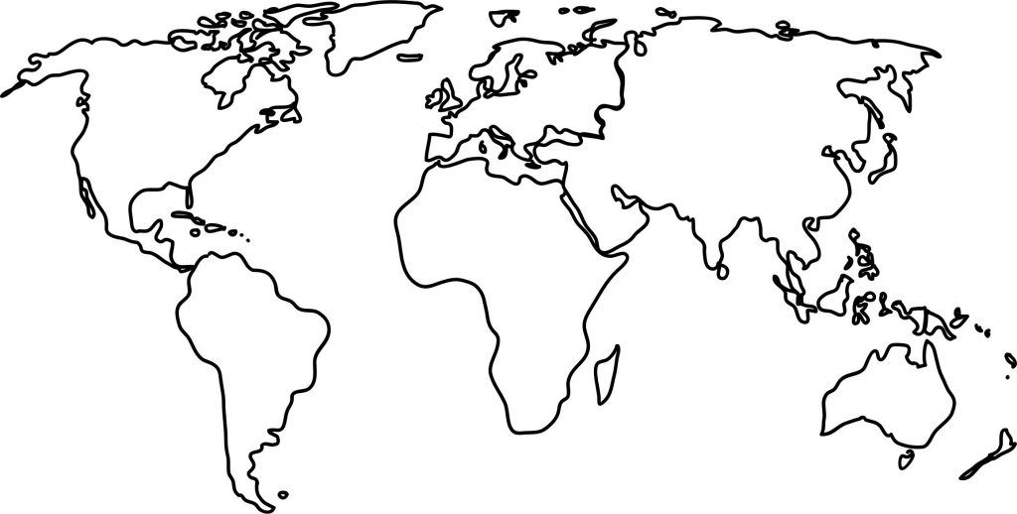







Notes:
And we need a framework like Hadoop to handle this huge data in a distributed environment. However…
<<click>>
there are multiple tools that work on top of Hadoop which make the task of working with big data a piece of cake. However, one of the tools that is used very popularly in the industry to work with big data on hadoop is
<<click>>
Hive.

Slide 4
Data Warehouse built on top of Hadoop
Analysis of big data in tabular format
Simple querying language
Notes:
<<click>>
Hive is actually a data warehouse built on top of hadoop. You can think of a data warehouse as a central repository where data is stored from various sources.
<<click>>
It is popularly used for analysis of big data as it presents the data in a tabular format just like you have in a relational database.
<<click>>
And it has a very simple querying language which is very similar to sql. So, in this course…

Slide 5
1. Introducing Hive
Notes:
first we will talk about the basics of hive. We will understand the overview of hive, why we need it and what is its basic architecture.

Slide 6

1. Introducing Hive
2. Basic Hive Commands
Notes:
Then we move on to implementing some basic commands in Hive. Here we will broadly cover the data definition commands that will come in handy while working in Hive.

Slide 7

1. Introducing Hive
2. Basic Hive Commands
3. Hive Query Language
Notes:
Once we cover that, we will look at the necessary commands for query the data in Hive. Here we will cover commands to filter data, group data, sort the data, and a couple of other commands.

Slide 8

1. Introducing Hive
2. Basic Hive Commands
3. Hive Query Language
4. Joins
Notes:
After this, we move onto implementing joins in Hive.

Slide 9

1. Introducing Hive
2. Basic Hive Commands
3. Hive Query Language
4. Joins
5. Partitioning & Bucketing
Notes:
Then we will cover the concepts of partitioning and bucketing in Hive which are extremely important when dealing with huge amounts of data in Hive.

Slide 10

1. Introducing Hive
2. Basic Hive Commands
3. Hive Query Language
4. Joins
5. Partitioning & Bucketing
6. File Formats
Notes:
After this, we will see how we can read different type of file format data in Hive because obviously, in a real-world, we will be dealing with various file formats. So it is extremely important that we know how to read such formats in Hive.

Slide 11

1. Introducing Hive
2. Basic Hive Commands
3. Hive Query Language
4. Joins
5. Partitioning & Bucketing
6. File Formats
7. Views in Hive
Notes:
Finally, we will have a look at how we can create and query with Views in Hive.

Slide 12


Instructors
Siddharth Sonkar
Aniruddha Bhandari
Harshit Nagpal

Slide 13

Course Support
Discussion Forum
Notes:
While going through the course if you get stuck anywhere or if you have any queries
Feel free to use the discussion forum

Slide 14

Course Support
Discussion Forum
Email - training_queries@analyticsvidhya.com
Notes:
Or you can also reach out to us through email
You can email us at training_support@analyticsvidhya.com

Slide 15
Thank You!

